Slide 1

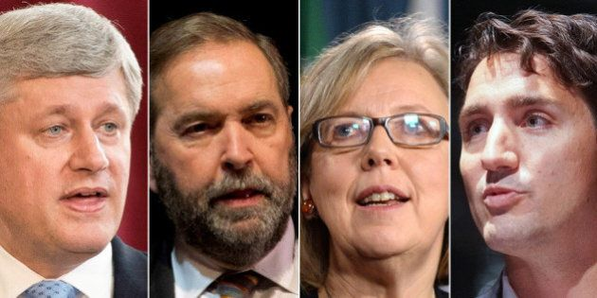
Canadian Federal Elections 2015
The data behind the vote
This Photo by Unknown Author is licensed under CC BY

Slide 2
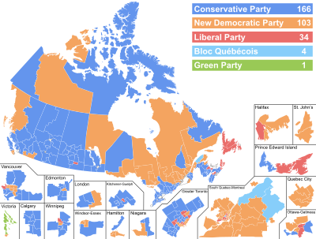

Slide 3
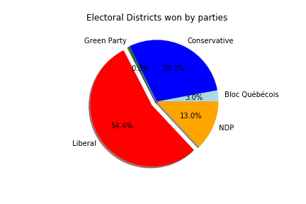

Slide 4


Hypothesis of factors influencing an Election
Age
Education
Gender
Turnout
Income

Slide 5
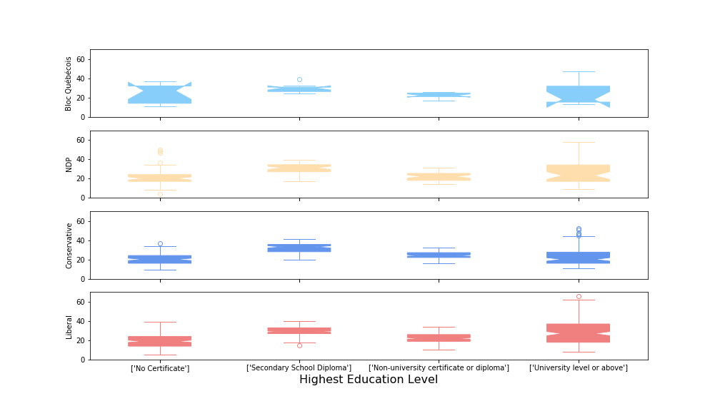
%Population by Highest Education Level
P=0.29
P=1.4x10⁻⁵
P=1.1x10⁻³⁰
P=1.9x10⁻³⁶

Slide 6
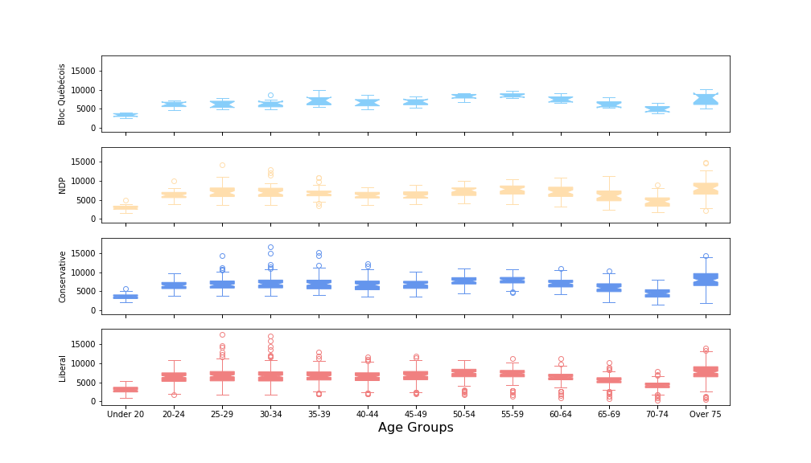
Riding Age Demographics, Grouped by Party
P=2.2x10⁻²⁰
P=5.2x10⁻⁵⁴
P=7.3x10⁻¹²⁰
P=2.9x10⁻¹⁹⁶

Slide 7
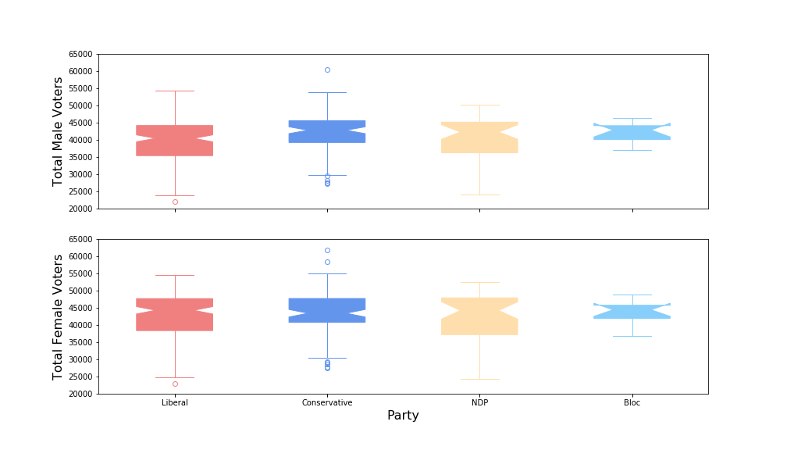
Male & Female Vote Totals Analyzed by Party
P=0.0079
P=0.44

Slide 8
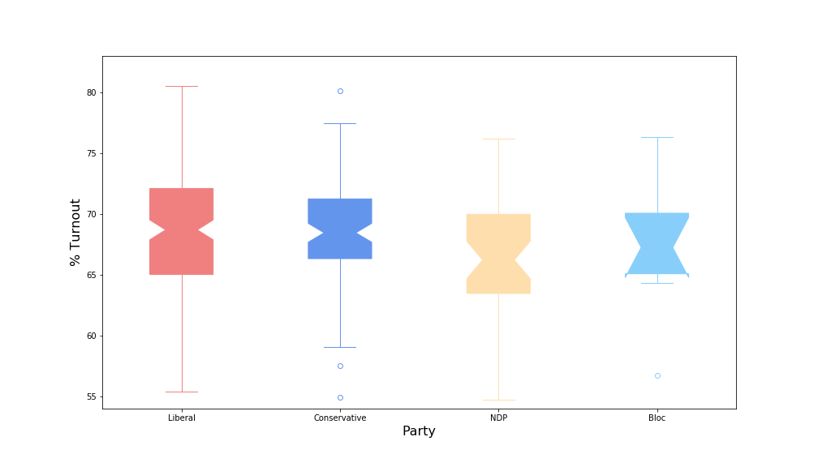
Turnout Analyzed by Party
P=0.24

Slide 9
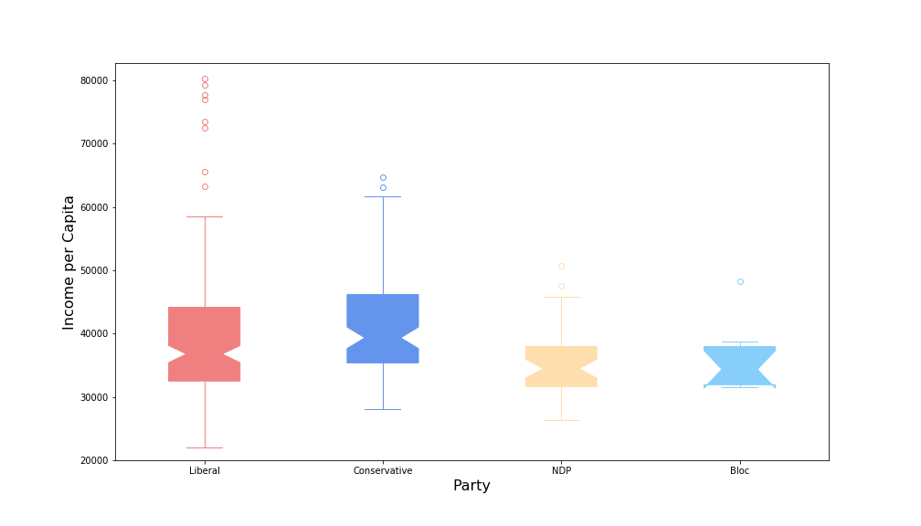
Income per Capita Analyzed by Party
P=0.0013

Slide 10
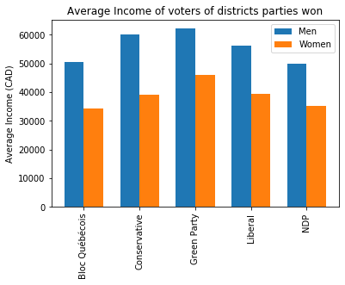
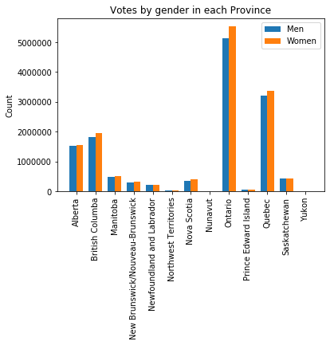
General Outlook

Slide 11
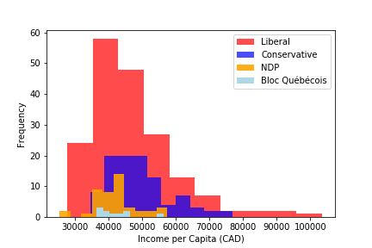

Slide 12
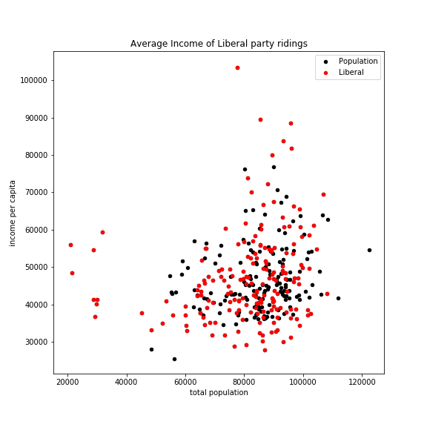
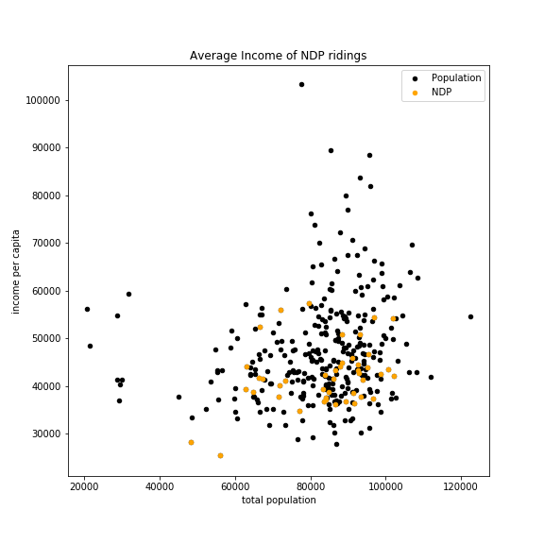
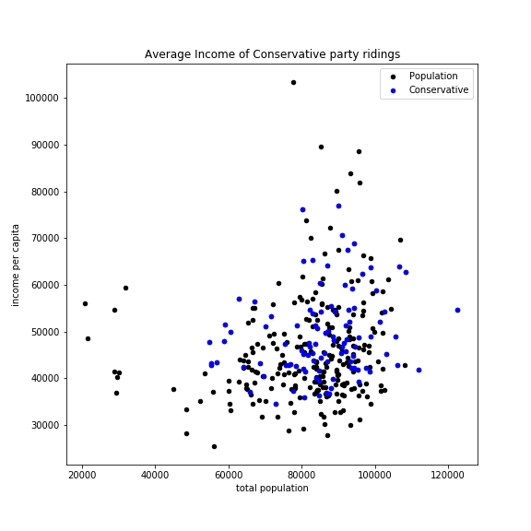
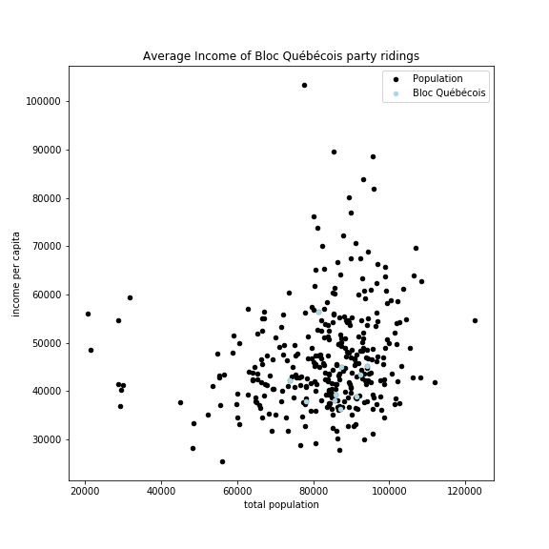

Slide 13
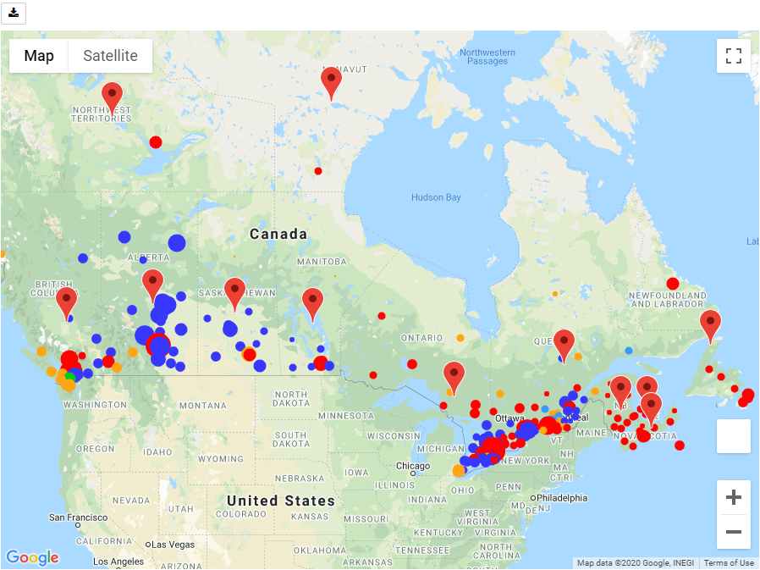
Elections on the Google Maps

Slide 14
Legend: Political Parties Colors
Liberal Party of Canada
Conservative Party of Canada
New Democratic Party
Bloc Québécois
Green Party of Canada

Slide 15

Legend: Per Capita Income
$16,740 to $23,100
$23,100 to $29,460
$29,460 to $35,800
$35,800 to $42,180
$42,180 to $48,540
$48,540 to $54,900
$54,900 to $61,260
$61,260 to $67,600
$67,600 to $73,980
$73,980 to $80,340

Slide 16
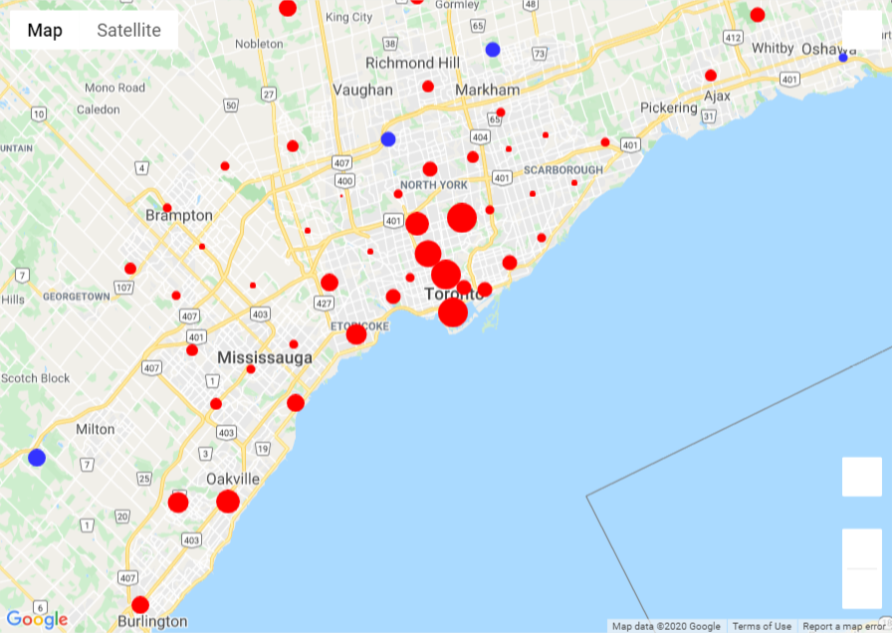
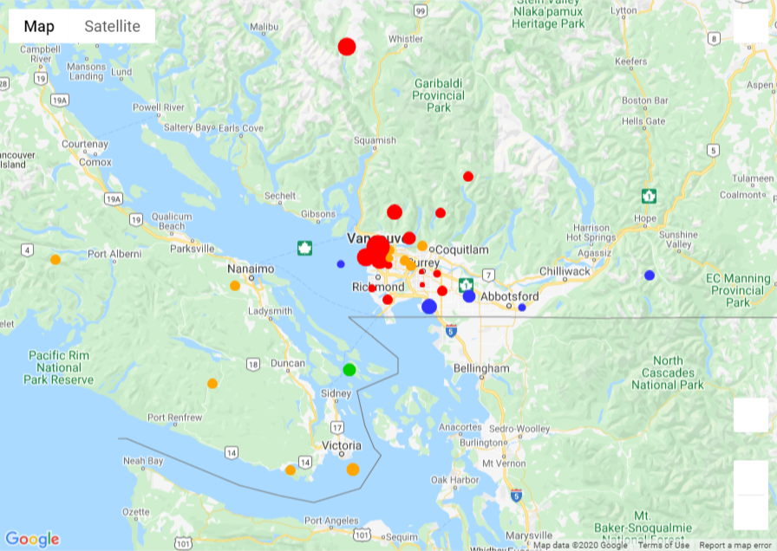
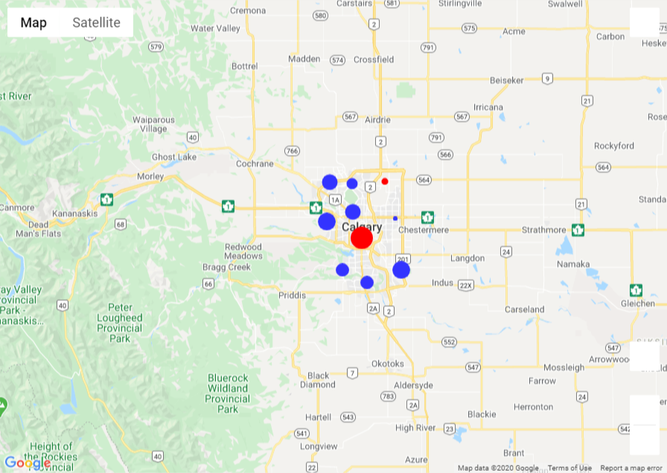
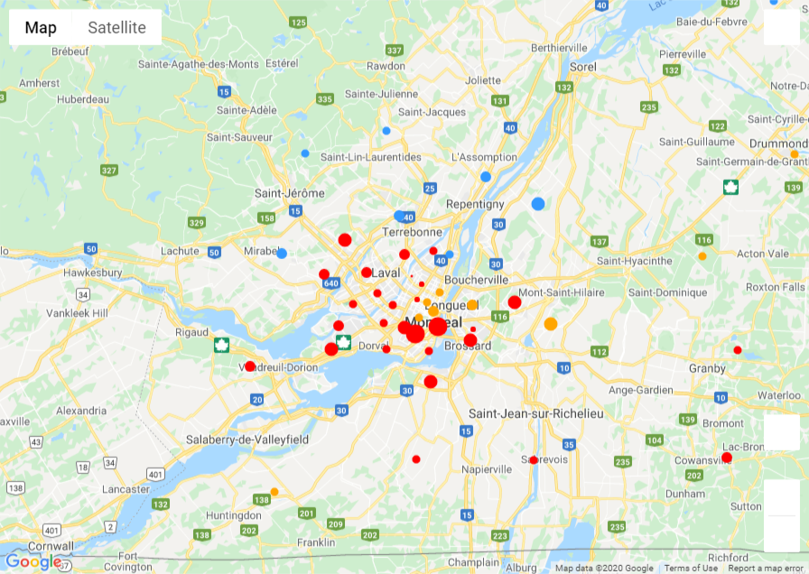
Observation 1: City Centres

Slide 17
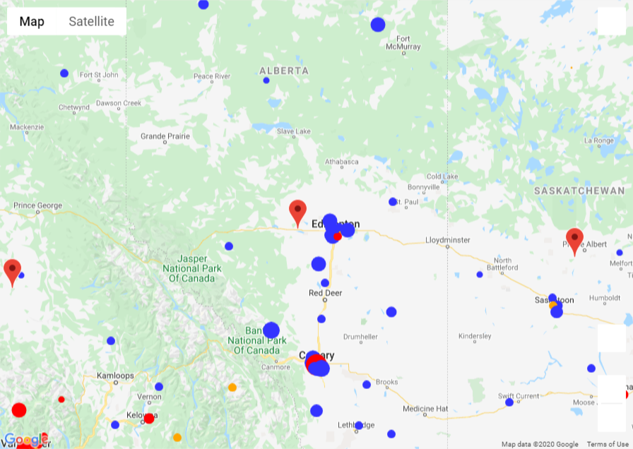
Observation 2: Conservatives in Alberta

Slide 18
Observation 3: NDP Support (vs Liberals)

Slide 19
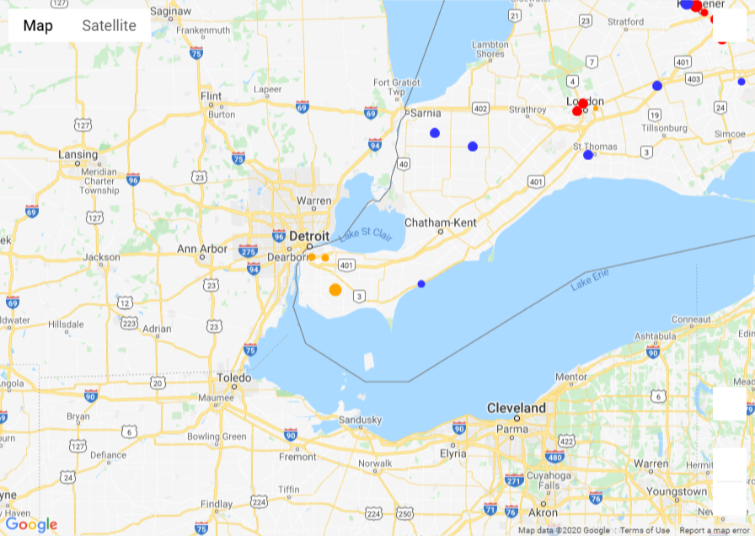
Observation 3: NDP Support (in Ontario)

Slide 20
Observation 3: NDP Support (in Québéc)

Slide 21
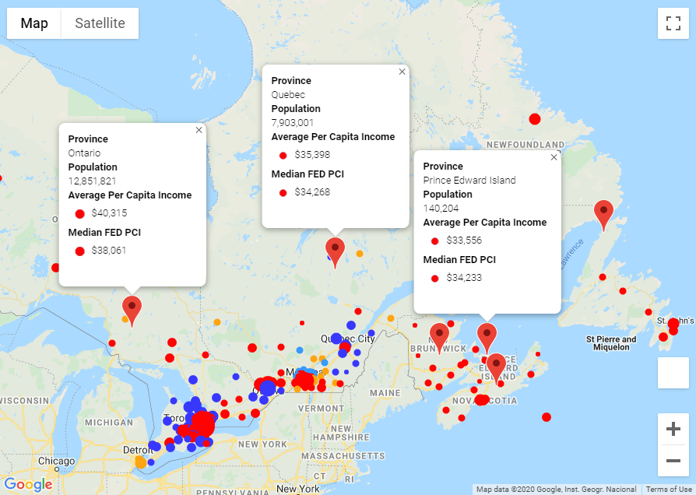
Observation 4: Social Inequality

Slide 22
Interactive Part

Slide 23
The End Q & A time

Slide 24
Map Data Preparation (optional)
Stats Canada: FED Borders 2013 (GML)
Coordinate Systems: NAD83 vs. WGS84
Converter Web API: epsg.io
Other Data Sources:
Elections Canada: election results and population data
CRA: income data per FED
Presentation:
Symbol layer for FED data
Marker layer for Province info boxes

